Slide 1
Econ 100 Principles of Economics
Lecture 23
May 24

Slide 2
Production and growth, contd.
Assignment 9 this Friday, related to unemployment

Slide 3
Production and Growth

Slide 4
Income differences around the world
http://econperspectives.blogspot.com/2008_08_01_archive.html

Slide 5
What a typical family eats
Hungry Planet: What the World Eats
Peter Menzel shows us the big differences in the standard-of-living around the globe by photographing what a typical family eats over the course of a week.

Slide 6
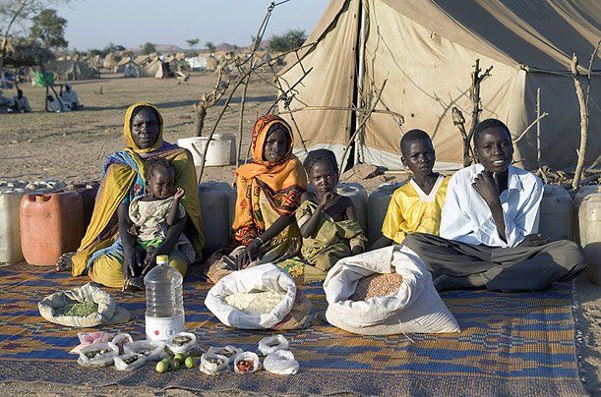
Chad: 2008 GDP per capita = $1,600.

Slide 7
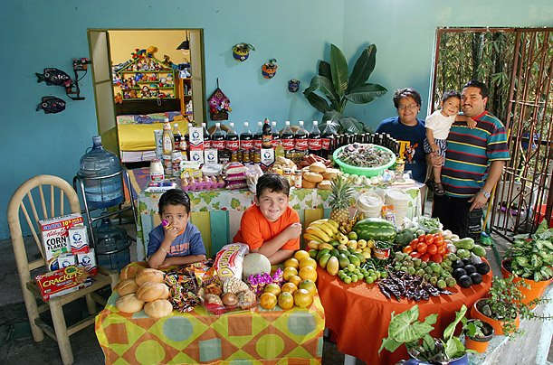
Mexico: 2008 GDP per capita = $14,200

Slide 8
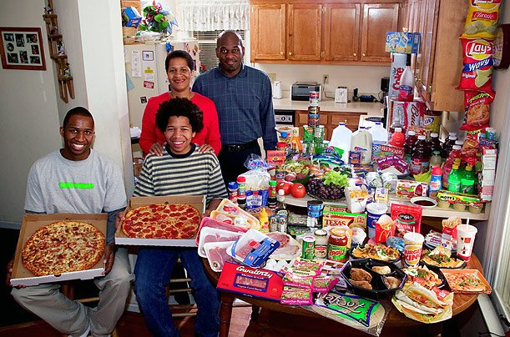
United States: 2008 GDP per capita = $47,000

Slide 9
The material possessions of a typical family
Material World: A Global Family Portrait
by Peter Menzel. The differences in economic growth around the world in photographs: the material possessions of a typical family in various countries.

Slide 10
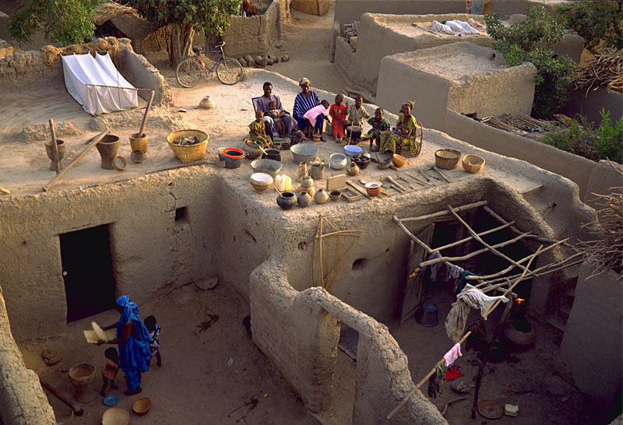

Slide 11
Mali: The Natomo Family
It is not unusual in this West African country for men to have two wives, as 39-year-old Soumana Natomo does. More wives mean more children—and a greater chance you will be supported in old age. Soumana now has eight children, and his wives, Pama Kondo (28) and Fatouma Niangani Toure (26), will likely have more. How many of these children will survive, though, is uncertain: Mali's infant mortality rate ranks among the ten highest in the world. Some of the family's possessions are not included in this photo—another mortar and pestle for pounding grain, two wooden mattress platforms, 30 mango trees, and old radio batteries that the children use as toys. (Note: The Natomos appear on the adobe roof of their house in Kouakourou. An infant son is nestled in his mother's arms. One daughter is absent.) Population: 12 million Total fertility rate: 7.0 children per woman Population doubling time: 23 years Percentage urban/rural: 26% urban, 64% rural Per capita energy use: 22 kg. oil equivalent Infant mortality: 118.7 deaths per 1,000 births Life expectancy: 48 (male), 49 (female) Adult illiteracy: 64% (male), 84% (female) Internet users: 30,000

Slide 12
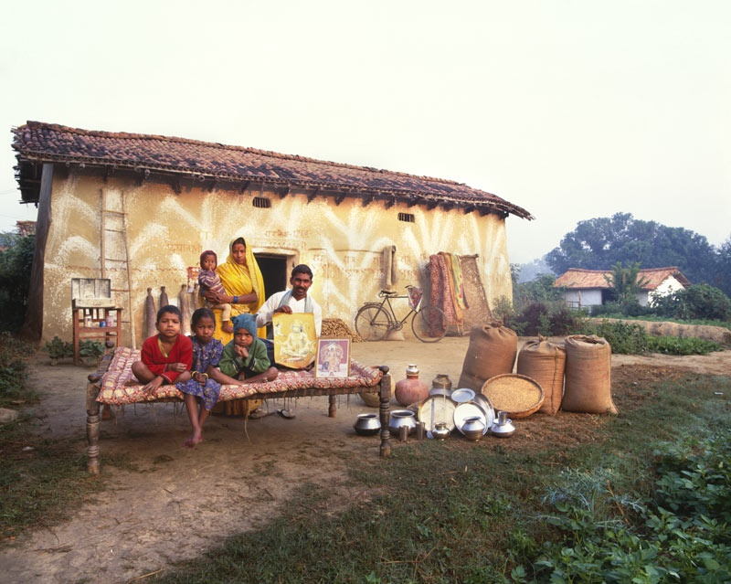

Slide 13
India: The Yadev Family
At age 25, Mashre Yadev is already mother to four children, the oldest of whom was born when she was 17. Each morning at their home in rural Uttar Pradesh, she draws water from a well so that her older children can wash before school. She cooks over a wood fire in a windowless, six-by-nine-foot kitchen, and such labor-intensive domestic work keeps her busy from dawn to dusk. Her husband Bachau, 32, works roughly 56 hours a week, when he can find work. In rough times, family members have gone more than two weeks with little food. Everything they own—including two beds, three bags of rice, a broken bicycle, and their most cherished belonging, a print of Hindu gods—appears in this photograph. Population: 1.0 billion Population density: 318 people per sq. km. Total fertility rate: 3.0 children per woman Population doubling time: 36 years Percentage urban/rural: 28% urban, 72% rural Per capita energy use: 494 kg. oil equivalent Infant mortality: 66 deaths per 1,000 births Life expectancy: 62 (male), 64 (female) Adult illiteracy: 32% (male), 55% (female) Internet users: 7 million

Slide 14
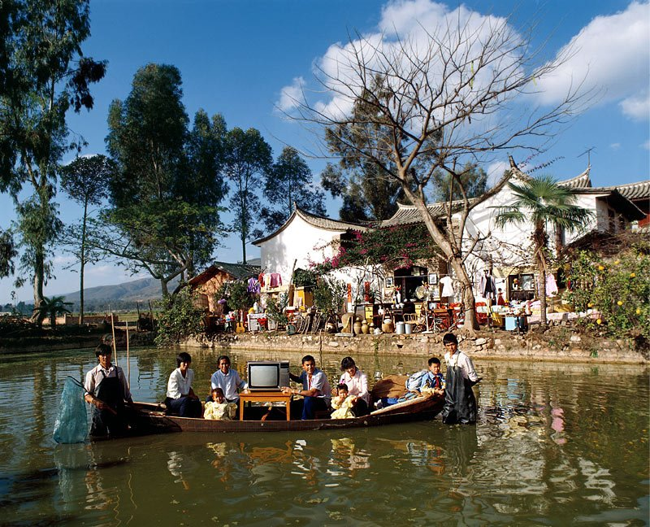

Slide 15
China: The Wu Family
The nine members of this extended family—father Wu Ba Jiu (59), mother Guo Yu Xian (57), their sons, daughters-in-law, and three grandchildren—live in a three-bedroom, 600-square-foot dwelling in rural Yunnan Province. While they have no telephone, they get news and images of a wider world through two radios and the family's most prized possession, a television. In the future, they hope to get one with a 30-inch screen as well as a VCR, a refrigerator, and drugs to combat diseases in the carp they raise in their ponds. Not included in the photo are their 100 mandarin trees, vegetable patch, and three pigs. Population: 1.3 billion Population density: 627 people per sq. km. Total fertility rate: 1.7 children per woman Population doubling time: 67 years Percentage urban/rural: 37% urban, 63% rural Per capita energy use: 905 kg. oil equivalent Infant mortality: 32 deaths per 1,000 births Life expectancy: 69 (male), 73 (female) Adult illiteracy: 7.9% (male), 22.1% (female) Internet users: 46 million

Slide 16


Slide 17
United States: The Skeen Family
Rick and Pattie Skeen's 1,600-square-foot house lies on a cul-de-sac in Pearland, Texas, a suburb of Houston. The fire hydrant in this photo is real, but not working—a souvenir from Rick's days as a firefighter. Rick, 36, now splices cables for a phone company. Pattie, 34, teaches school at a Christian academy. To get the picture, photographers hoisted the family up in a cherry picker. Yet the image still leaves out a refrigerator-freezer, camcorder, woodworking tools, computer, glass butterfly collection, trampoline, fishing equipment, and the rifles Rick uses for deer hunting, among other things. Though rich with possessions, nothing is as important to the Skeens as their Bible. For this devoutly Baptist family, like many families around the world, it is a spiritual—rather than material—life that matters most. Population: 292 million Population density: 29 people per sq. km. Total fertility rate: 2.0 children per woman Population doubling time: 116 years Percentage urban/rural: 78% urban, 22% rural Per capita energy use: 8,148 kg. oil equivalent Infant mortality: 6.7 deaths per 1,000 births Life expectancy: 74 (male), 80 (female) Adult illiteracy: 3% (male), 3% (female) Internet users: 165 million

Slide 18
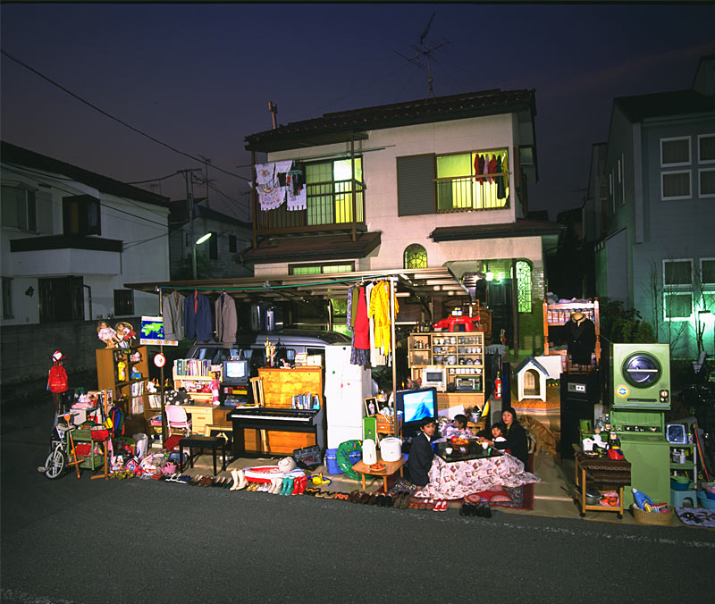

Slide 19
Japan: The Ukita Family
Like many Japanese women, 43-year-old Sayo Ukita had children relatively late in life. Her youngest daughter is now in kindergarten, not yet burdened by the pressures of exams and Saturday "cram school" that face her nine-year-old sister. Sayo is supremely well-organized, which helps her manage the busy schedules of her children and maintain order in their 1,421-square-foot Tokyo home stuffed with clothes, appliances, and an abundance of toys for both her daughters and dog. She and her husband Kazuo, 45, have all the electronic and gas-powered conveniences of modern life, but their most cherished possessions are a ring and heirloom pottery. The family's wish for the future: a larger house with more storage space. Population: 128 million Population density: 336 people per sq. km. Total fertility rate: 1.3 children per woman Population doubling time: 289 years Percentage urban/rural: 79% urban, 21% rural Per capita energy use: 4,316 kg. oil equivalent Infant mortality: 3 deaths per 1,000 births Life expectancy: 78 (male), 85 (female) Adult illiteracy: 1% (male), 1% (female) Internet users: 56 million

Slide 20
How big is the world economy?
GDP figures for rich countries, 2013

Slide 21
GDP figures around the world 2013 World Development Indicators database, World Bank, 22 September 2014
World 74,909,811 (this is 75 trillions of USD)
Euro area 12,749,677
For 2022
Euro area 15.07trillions of USD
World 105.57 trillions of USD

Slide 22
http://databank.worldbank.org/data/download/GDP.pdf
Gross domestic product 2021
(millions of
Ranking Economy US dollars)
1 United States 23,315,081
2 China 17,734,063
3 Japan 4,940,878
4 Germany 4,259,935
5 India 3,176,295
6 United Kingdom 3,131,378
7 France 2,957,880
8 Italy 2,107,703
9 Canada 1,988,336
10 Korea, Rep. 1,810,956

Slide 23
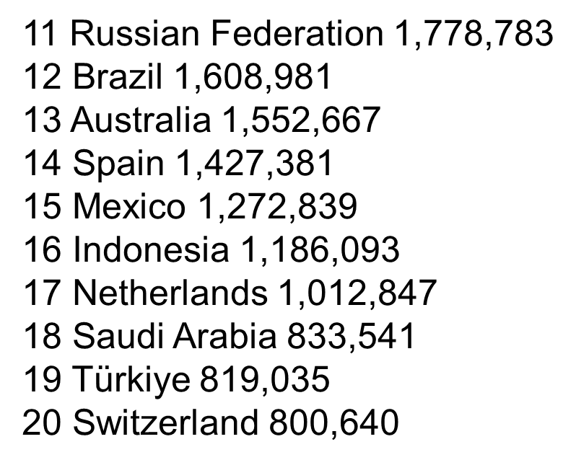

Slide 24
The GDP ranking with PPP
PPP is purchasing power parity; an international dollar has the same purchasing power over GDP as a U.S. dollar has in the United

Slide 25
http://databank.worldbank.org/data/download/GDP_PPP.pdf

Slide 26
Is the US the richest country in the world?
The US has the highest GDP per capita according to the PPP method.
Does it mean that the US is the richest country in the world?
Not exactly!
The US is by far the most unequal country in the developed world.

Slide 27
Incomes and Growth Around the World
 | GDP per capita, 2009 | Growth rate, 1970–2009
China | $6,828 | 7.4%
Singapore | $50,633 | 4.7%
India | $3,296 | 3.3%
Japan | $32,418 | 2.2%
Spain | $32,150 | 2.1%
Israel | $27,656 | 2.1%
Colombia | $8,959 | 1.9%
United States | $45,989 | 1.8%
Canada | $37,808 | 1.7%
Philippines | $3,542 | 1.3%
Rwanda | $1,136 | 1.1%
New Zealand | $28,993 | 1.1%
Argentina | $14,538 | 1.0%
Saudi Arabia | $23,480 | 0.6%
Chad | $1,300 | 0.4%
FACT 1:
Big differences in living standards around the world.
Notes:
27

Slide 28
Incomes and Growth Around the World
 | GDP per capita, 2009 | Growth rate, 1970–2009
China | $6,828 | 7.4%
Singapore | $50,633 | 4.7%
India | $3,296 | 3.3%
Japan | $32,418 | 2.2%
Spain | $32,150 | 2.1%
Israel | $27,656 | 2.1%
Colombia | $8,959 | 1.9%
United States | $45,989 | 1.8%
Canada | $37,808 | 1.7%
Philippines | $3,542 | 1.3%
Rwanda | $1,136 | 1.1%
New Zealand | $28,993 | 1.1%
Argentina | $14,538 | 1.0%
Saudi Arabia | $23,480 | 0.6%
Chad | $1,300 | 0.4%
FACT 2:
Huge variations in growth rates across countries.
These are average growth rate over a 40 year period.
Notes:
28

Slide 29
Thus, the question is…

Slide 30
What determines a country’s standard of living?
The answer is…

Slide 31
Productivity
A country’s standard of living depend on its ability to produce goods and services.
This ability depends on productivity, the average quantity of goods and services produced per unit of labor input.
Y = real GDP = quantity of output produced L = quantity of labor So productivity = Y/L (output per worker)

Slide 32
Why Productivity Is So Important
When a nation’s workers are very productive, real GDP is large and incomes are high.
When productivity grows rapidly, so do living standards.
What, then, determines productivity and its growth rate?

Slide 33
Physical Capital Per Worker
The stock of equipment and structures used to produce goods service is called [physical] capital, denoted K.
K/L = capital per worker.
Productivity is higher when the average worker has more capital (machines, equipment, etc.).
i.e., an increase in K/L causes an increase in Y/L.

Slide 34
Human Capital Per Worker
Human capital (H): the knowledge and skills workers get through education, training, and experience.
H/L = the average worker’s human capital
Productivity is higher when the average worker has more human capital (education, skills, training, etc.).
i.e., an increase in H/L causes an increase in Y/L.

Slide 35
Natural Resources Per Worker
Natural resources (N): the inputs into production that nature provides, e.g., land, mineral deposits
Some countries are rich because they have abundant natural resources (e.g., Saudi Arabia has lots of oil).
But countries need not have much N to be rich (e.g., Japan imports the N it needs).

Slide 36
Technological Knowledge
Technological knowledge: society’s understanding of the best ways to produce goods and services.
Technological progress does not only mean a faster computer, a higher-definition TV, or a smaller cell phone.
It means any advance in knowledge that increases productivity (allows society to get more output from its resources).
e.g., Henry Ford and the assembly line.

Slide 37
Tech. Knowledge vs. Human Capital
Technological knowledge refers to society’s understanding of how to produce goods and services.
Human capital results from the effort people expend to acquire this knowledge.
Both are important for productivity.

